Slide 1
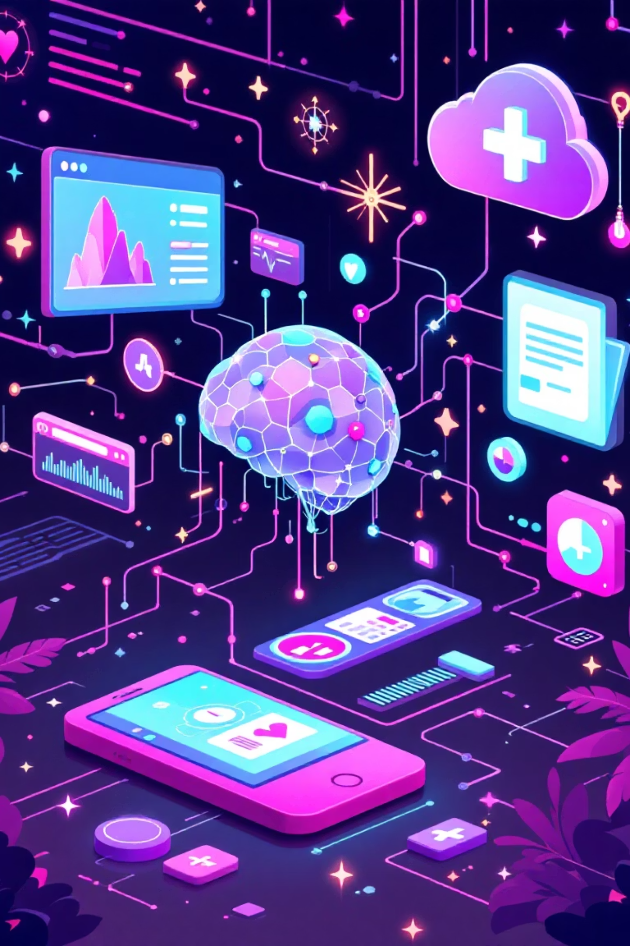
U-DOC: AI-Powered Clinical Document Intelligence
Leveraging Multi-modal AI for Automated Prescription Analysis and Decision Support
Presenter
Institution
Bineet Bairagi
Techno India University
ID: 231003003073
AI-ML Enthusiast | Healthcare Innovation

Slide 2






The Clinical Data Challenge
High-Risk Data
Administrative Burden
Locked Information
Illegible handwriting and scanned documents cause transcription errors.
Manual data entry diverts clinicians from patient care.
Unstructured data remains unsearchable and isolated from EHRs.

Slide 3
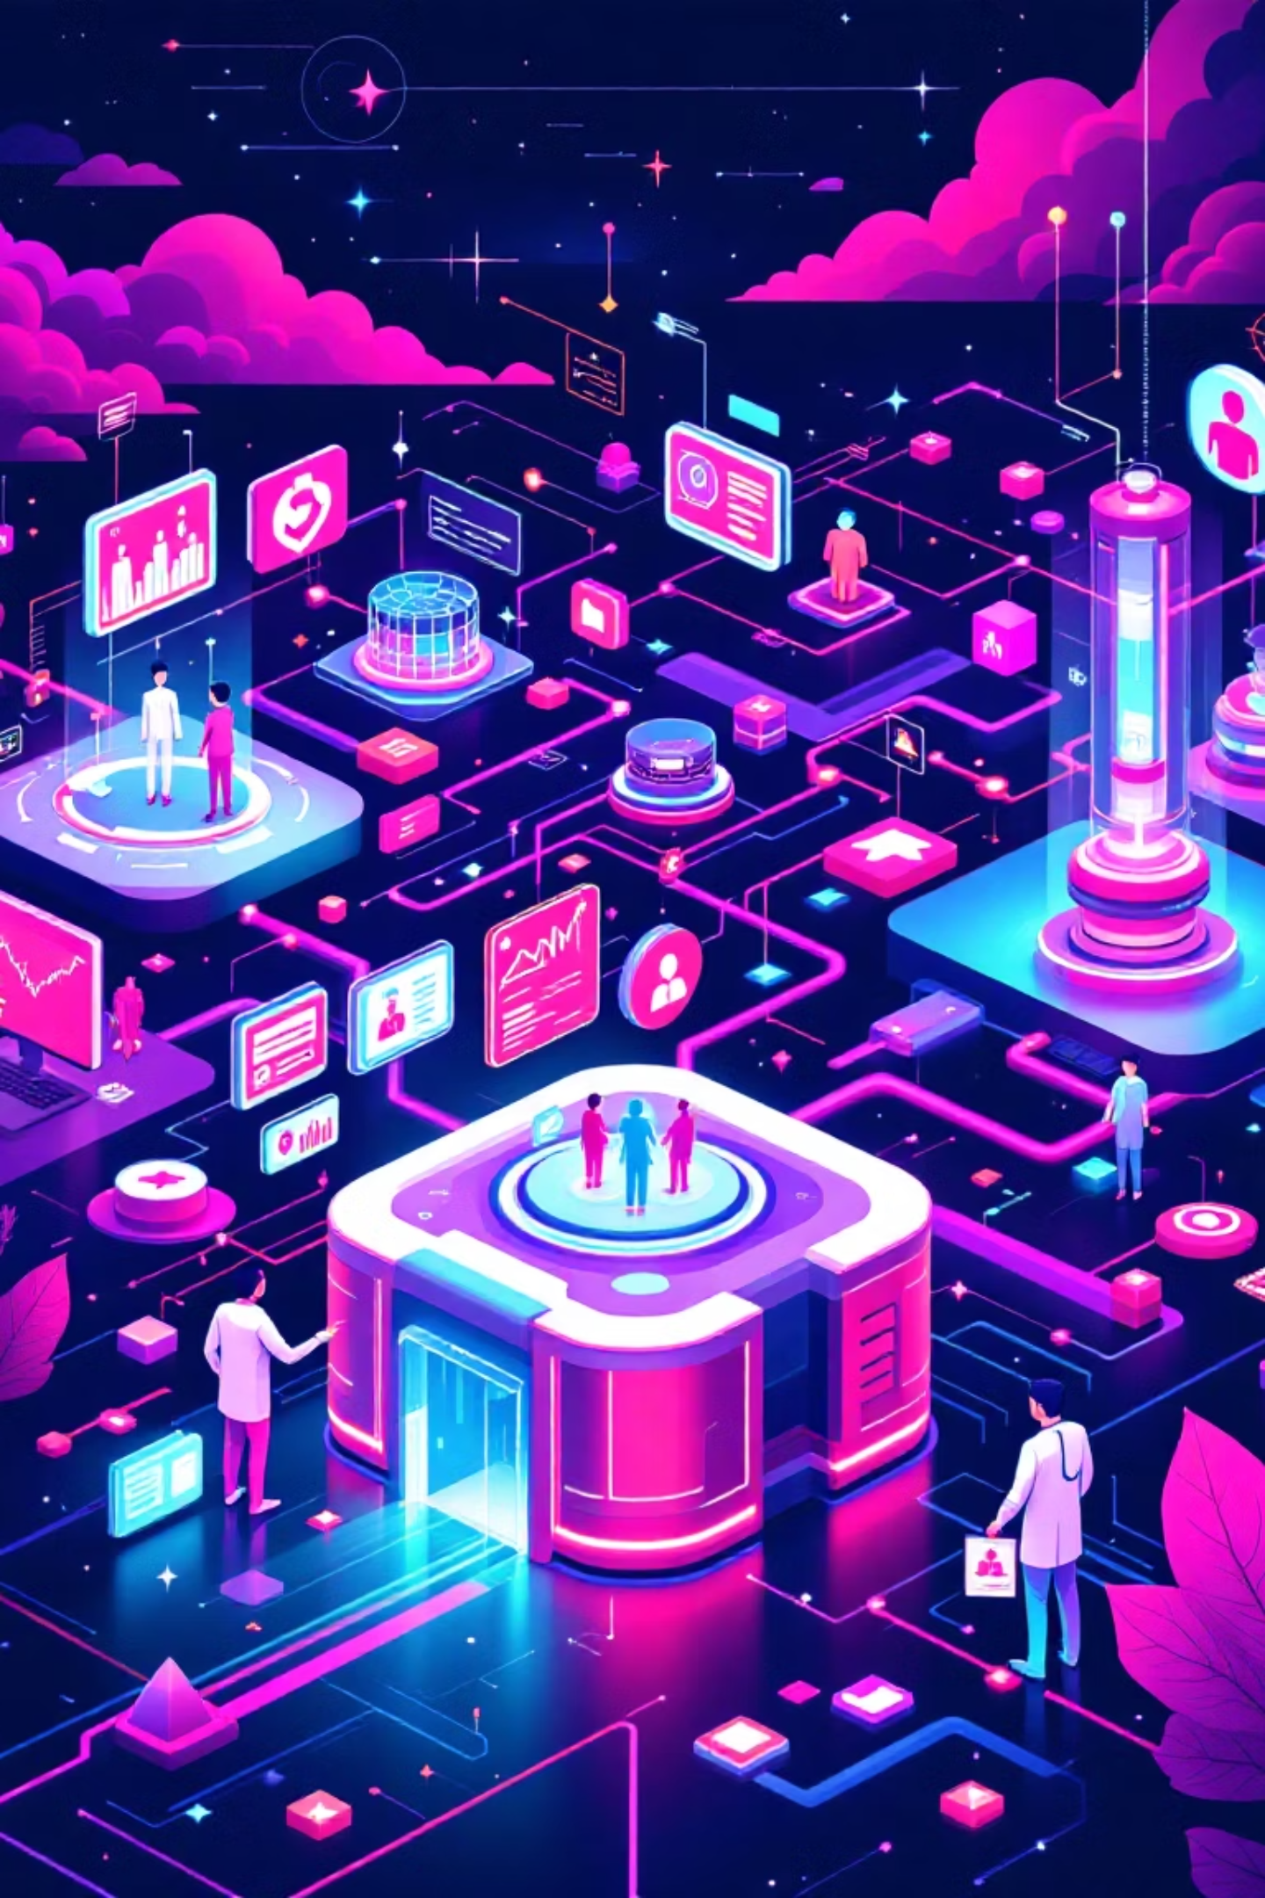

Impact & Future Vision
U-DOC bridges unstructured physical documents and structured digital data, reducing medication errors and automating administrative tasks to enhance patient safety and clinician efficiency.
Current State
Streamlit app with Gemini-powered extraction and chat
Near Term
Full EHR integration via FHIR APIs
Future
Production-grade RAG with vector database and clinical validation trials

Slide 4

Retrieval-Augmented Chat
The U-DOC solution includes an interactive chat interface, allowing clinicians to query the extracted information for decision support. This demonstrates how U-DOC can provide instant, accurate responses based on parsed clinical documents.
User: "What is the dosage for Amoxicillin?"
U-DOC: "250mg, three times daily."
User: "Any clinical flags?"
U-DOC: "Yes—Allergy: Penicillin noted."
This capability enhances clinician efficiency by providing immediate access to critical patient information, reducing the time spent searching through records, and minimizing potential medication errors.

Slide 5
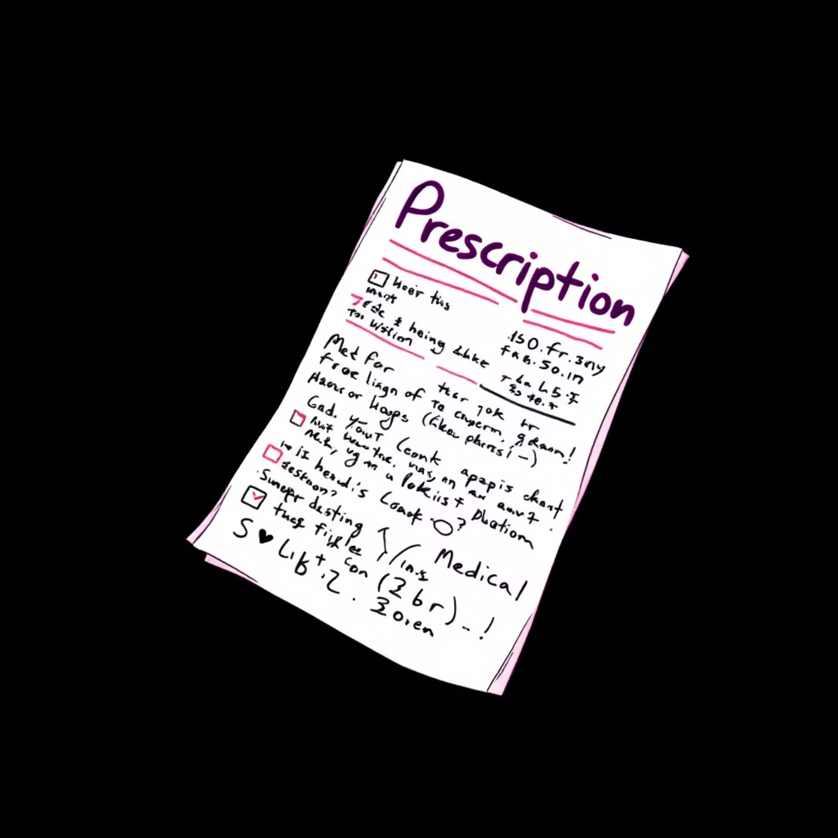
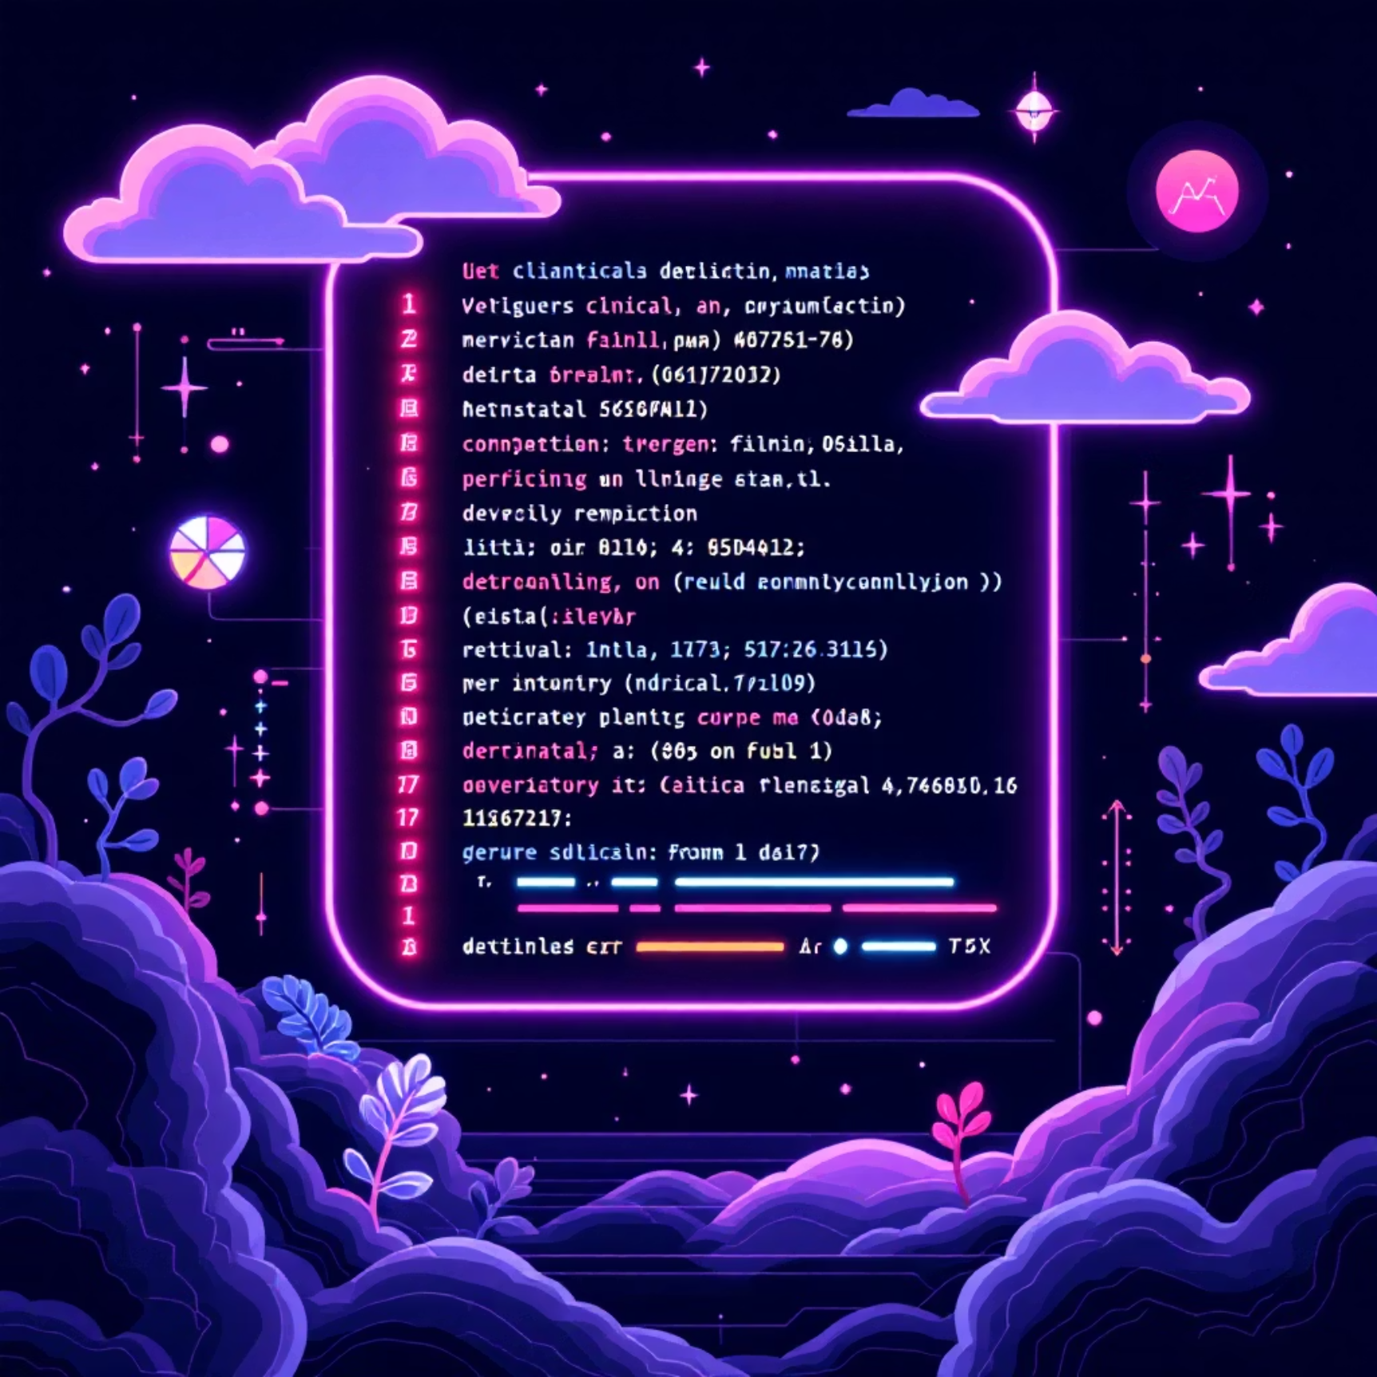
Structured Information Extraction
Before: Handwritten Prescription
After: Clean Structured Data
Handwritten prescription with unclear notation
Clean structured data—Medicine: Amoxicillin, Dosage: 250mg, Frequency: Three times daily

Slide 6
Core Technologies & Architecture
Tech Stack
Key Process
Frontend: Streamlit
Multi-modal prompting to Gemini API
Core: Google Gemini LVLM
JSON schema enforcement for reliability
Image Processing: PIL & PyMuPDF
100% structured output guarantee

Slide 7




The U-DOC Solution
A Streamlit web application using Google Gemini's Large Vision-Language Model to act as a clinical co-pilot: Read any document, Understand and extract structured data, and Interact through intelligent chat for decision support.
Ingestion
Multi-modal AI
Structured Output
Upload image, PDF, or handwritten note
Gemini processes and understands content
JSON data + chat interface

